Slide 1
Disjoint Set Operations

Slide 2
Kruskal’s Algorithm
8
7
B
C
D
4
9
2
11
4
A
I
14
E
7
6
8
10
1
2
H
G
F

Slide 3
Union-Find
Make-Set(x)
Creates a new set whose only member is x
O(1)
MakeUnionFind(S)
MakeSet(x) with each v \in V
8
7
B
C
D
4
9
2
11
4
A
I
14
E
7
6
8
10
1
2
H
G
F

Slide 4
Union-Find
Find(x)
Return a pointer to the representative/name of the set containing x
Find(C) = Red/ Pointer to C or I
8
7
B
C
D
4
9
2
11
4
A
I
14
E
7
6
8
10
1
2
H
G
F

Slide 5
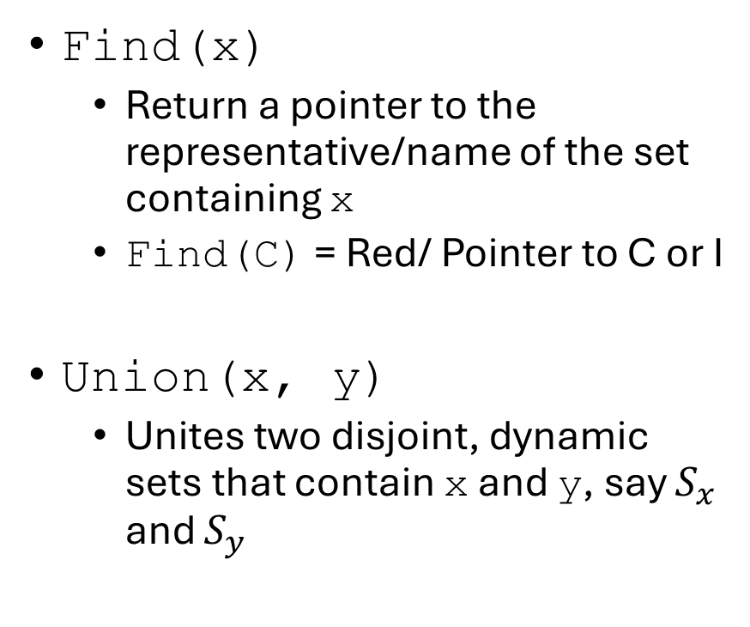
Union-Find
Find(x)
Return a pointer to the representative/name of the set containing x
Find(C) = Red/ Pointer to C or I
Union(x, y)
Unites two disjoint, dynamic sets that contain x and y, say $S_{x}$ and $S_{y}$
8
7
B
C
D
4
9
2
11
4
A
I
14
E
7
6
8
10
1
2
H
G
F

Slide 6
Union-Find
Maintain an array Component
Contains the name of the set currently containing each element.
Name of the set
Pointer to a representative node
Name of the representative node
8
7
B
C
D
4
9
2
11
4
A
I
14
E
7
6
8
10
1
2
H
G
F

Slide 7
Union-Find
Components
Maintain an array Component
Contains the name of the set currently containing each element.
Name of the set
Pointer to a representative node
Name of the representative node
Index of the representative node
1
1
3
4
5
6
6
6
3
1
2
3
4
5
6
7
8
9
8
7
2
3
4
4
9
2
11
4
1
9
14
5
7
6
8
10
1
2
8
7
6

Slide 8

Union-Find
Components
Initially set $Component[s]=s$ for all s.
1
2
3
4
5
6
7
8
9
1
2
3
4
5
6
7
8
9
8
7
2
3
4
4
9
2
11
4
1
9
14
5
7
6
8
10
1
2
8
7
6

Slide 9
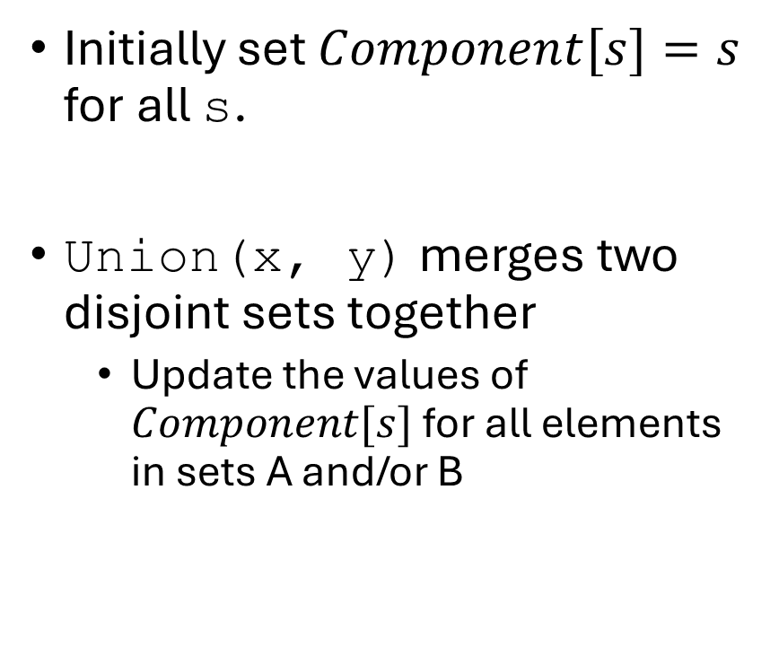
Union-Find
Components
Initially set $Component[s]=s$ for all s.
Union(x, y) merges two disjoint sets together
Update the values of $Component[s]$ for all elements in sets A and/or B
1
1
3
4
5
6
7
8
9
1
2
3
4
5
6
7
8
9
8
7
2
3
4
4
9
2
11
4
1
9
14
5
7
6
8
10
1
2
8
7
6

Slide 10
Union-Find
Components
Initially set Component[s]=s for all s
Union(x, y) merges two disjoint sets together
Update the values of Component[s] for all elements in sets A and/or B
1
1
3
4
5
6
6
6
3
1
2
3
4
5
6
7
8
9
8
7
2
3
4
4
9
2
11
4
1
9
14
5
7
6
8
10
1
2
8
7
6

Slide 11
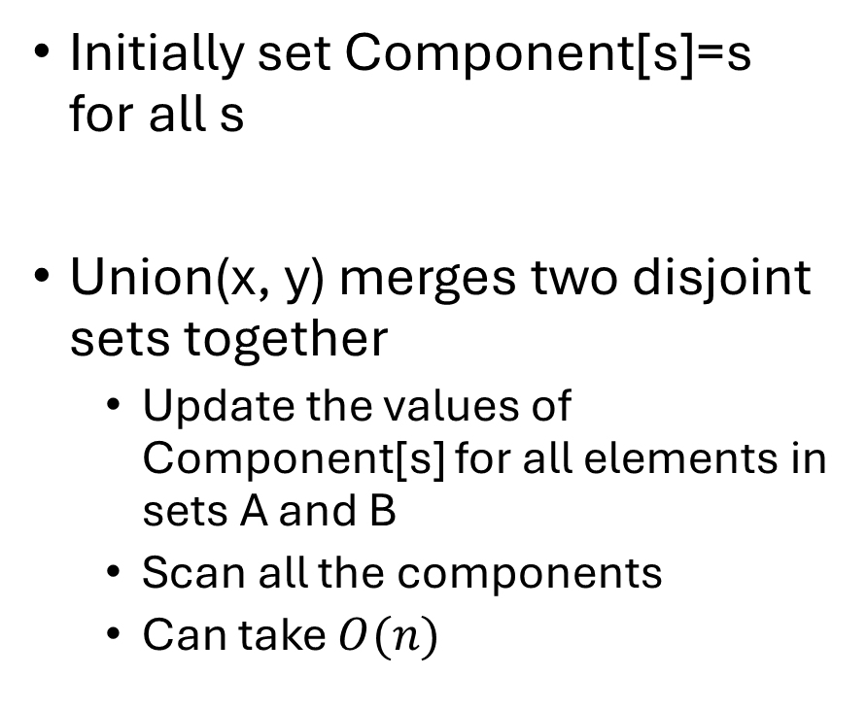
Union-Find
Components
Initially set Component[s]=s for all s
Union(x, y) merges two disjoint sets together
Update the values of Component[s] for all elements in sets A and B
Scan all the components
Can take $O(n)$
1
1
3
4
5
3
3
3
3
1
2
3
4
5
6
7
8
9
8
7
2
3
4
4
9
2
11
4
1
9
14
5
7
6
8
10
1
2
8
7
6

Slide 12

Union-Find
Components
Find(x)
Return Components[x]
Takes $O(1)$
1
1
3
4
5
3
3
3
3
1
2
3
4
5
6
7
8
9
8
7
2
3
4
4
9
2
11
4
1
9
14
5
7
6
8
10
1
2
8
7
6

Slide 13
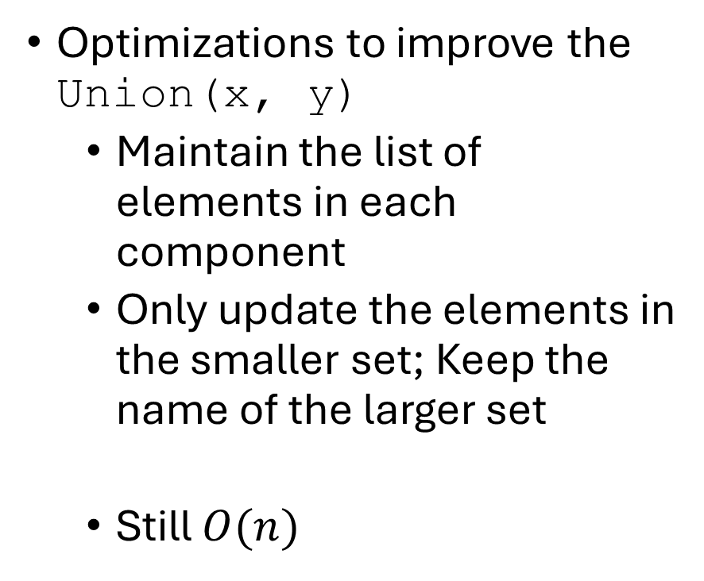
Union-Find
Components
Optimizations to improve the Union(x, y)
Maintain the list of elements in each component
Only update the elements in the smaller set; Keep the name of the larger set
Still $O(n)$
1
1
3
4
5
3
3
3
3
1
2
3
4
5
6
7
8
9
8
7
2
3
4
4
9
2
11
4
1
9
14
5
7
6
8
10
1
2
8
7
6

Slide 14
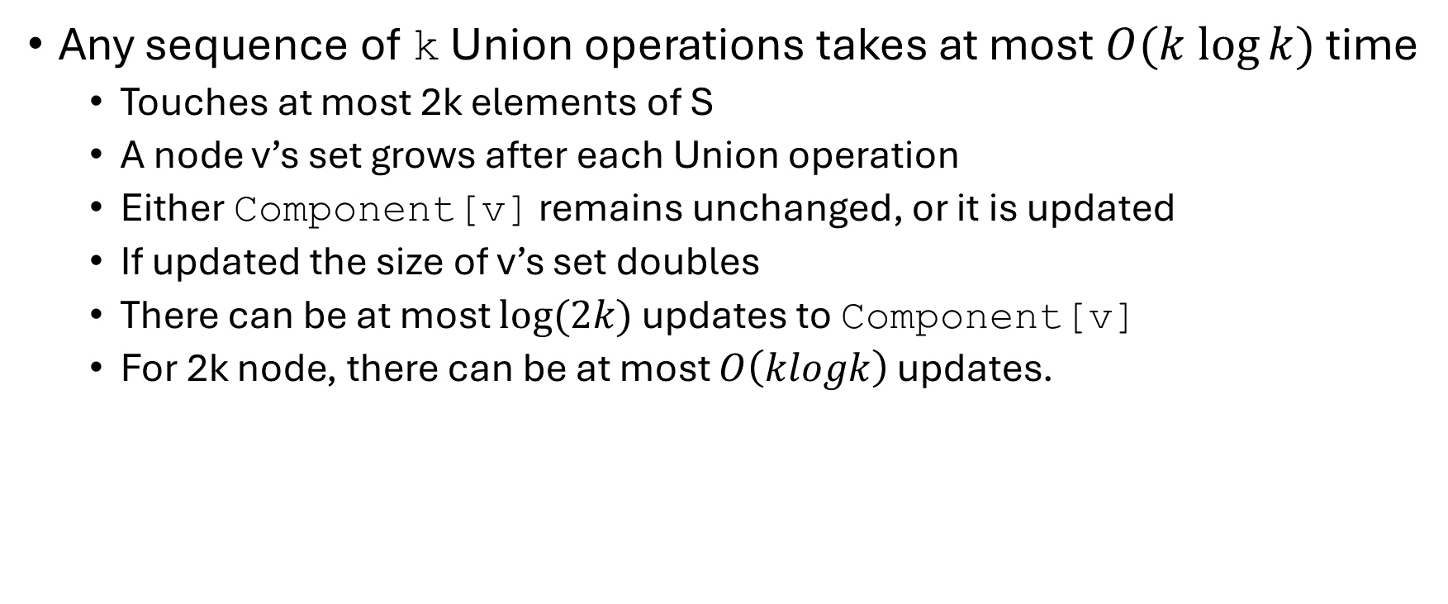
Union-Find
Any sequence of k Union operations takes at most $O(k log⁡k)$ time
Touches at most 2k elements of S
A node v’s set grows after each Union operation
Either Component[v] remains unchanged, or it is updated
If updated the size of v’s set doubles
There can be at most $log⁡(2k)$ updates to Component[v]
For 2k node, there can be at most $O\left(klogk\right)$ updates.

Slide 15
A Better Union-Find
Parents
Each node v will point to the representative node of its set.
MakeUnionFind(S) initializes a record for each element v with a pointer that points to itself
To indicate that v is in its own set.
1
2
3
4
5
6
7
8
9
1
2
3
4
5
6
7
8
9
8
7
2
3
4
4
9
2
11
4
1
9
14
5
7
6
8
10
1
2
8
7
6

Slide 16
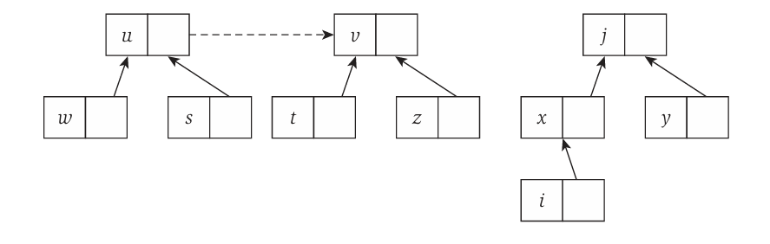
A Better Union-Find
Consider a Union(x, y)
Set either x or y be the name of the combined set (preferably from the larger set)
Assume we select y as the name.
Simply update x’s pointer to point to y.
We do not update the pointers at the other nodes in x’s set.

Slide 17
A Better Union-Find
Parents
Consider a Union(x, y)
Set either x or y be the name of the combined set
Assume we select y as the name.
Simply update x’s pointer to point to y.
We do not update the pointers at the other nodes in x’s set.
1
2
3
4
5
6
8
8
9
1
2
3
4
5
6
7
8
9
8
7
2
3
4
4
9
2
11
4
1
9
14
5
7
6
8
10
1
2
8
7
6

Slide 18
A Better Union-Find
Parents
Consider a Union(x, y)
The idea is to have either x or y be the name of the combined set
Assume we select y as the name.
Simply update x’s pointer to point to y.
We do not update the pointers at the other nodes in x’s set.
1
2
3
4
5
6
8
8
3
1
2
3
4
5
6
7
8
9
8
7
2
3
4
4
9
2
11
4
1
9
14
5
7
6
8
10
1
2
8
7
6

Slide 19
A Better Union-Find
Parents
Consider a Union(x, y)
The idea is to have either x or y be the name of the combined set
Assume we select y as the name.
Simply update x’s pointer to point to y.
We do not update the pointers at the other nodes in x’s set.
1
2
3
4
5
7
8
8
3
1
2
3
4
5
6
7
8
9
8
7
2
3
4
4
9
2
11
4
1
9
14
5
7
6
8
10
1
2
8
7
6

Slide 20
A Better Union-Find
Parents
Consider a Union(x, y)
The idea is to have either x or y be the name of the combined set
Assume we select y as the name.
Simply update x’s pointer to point to y.
We do not update the pointers at the other nodes in x’s set.
1
1
3
4
5
7
8
8
3
1
2
3
4
5
6
7
8
9
8
7
2
3
4
4
9
2
11
4
1
9
14
5
7
6
8
10
1
2
8
7
6

Slide 21
A Better Union-Find
Parents
Consider a Union(x, y)
The idea is to have either x or y be the name of the combined set
Assume we select y as the name.
Simply update x’s pointer to point to y.
We do not update the pointers at the other nodes in x’s set.
1
1
6
4
5
7
8
8
3
1
2
3
4
5
6
7
8
9
8
7
2
3
4
4
9
2
11
4
1
9
14
5
7
6
8
10
1
2
8
7
6

Slide 22
A Better Union-Find
Parents
Union(x, y)
Takes O(1)
Find(x)
Cannot simply return Parents[s]
Traverse through the pointers to the top
No longer O(1)
1
1
6
4
5
7
8
8
3
1
2
3
4
5
6
7
8
9
8
7
2
3
4
4
9
2
11
4
1
9
14
5
7
6
8
10
1
2
8
7
6

Slide 23
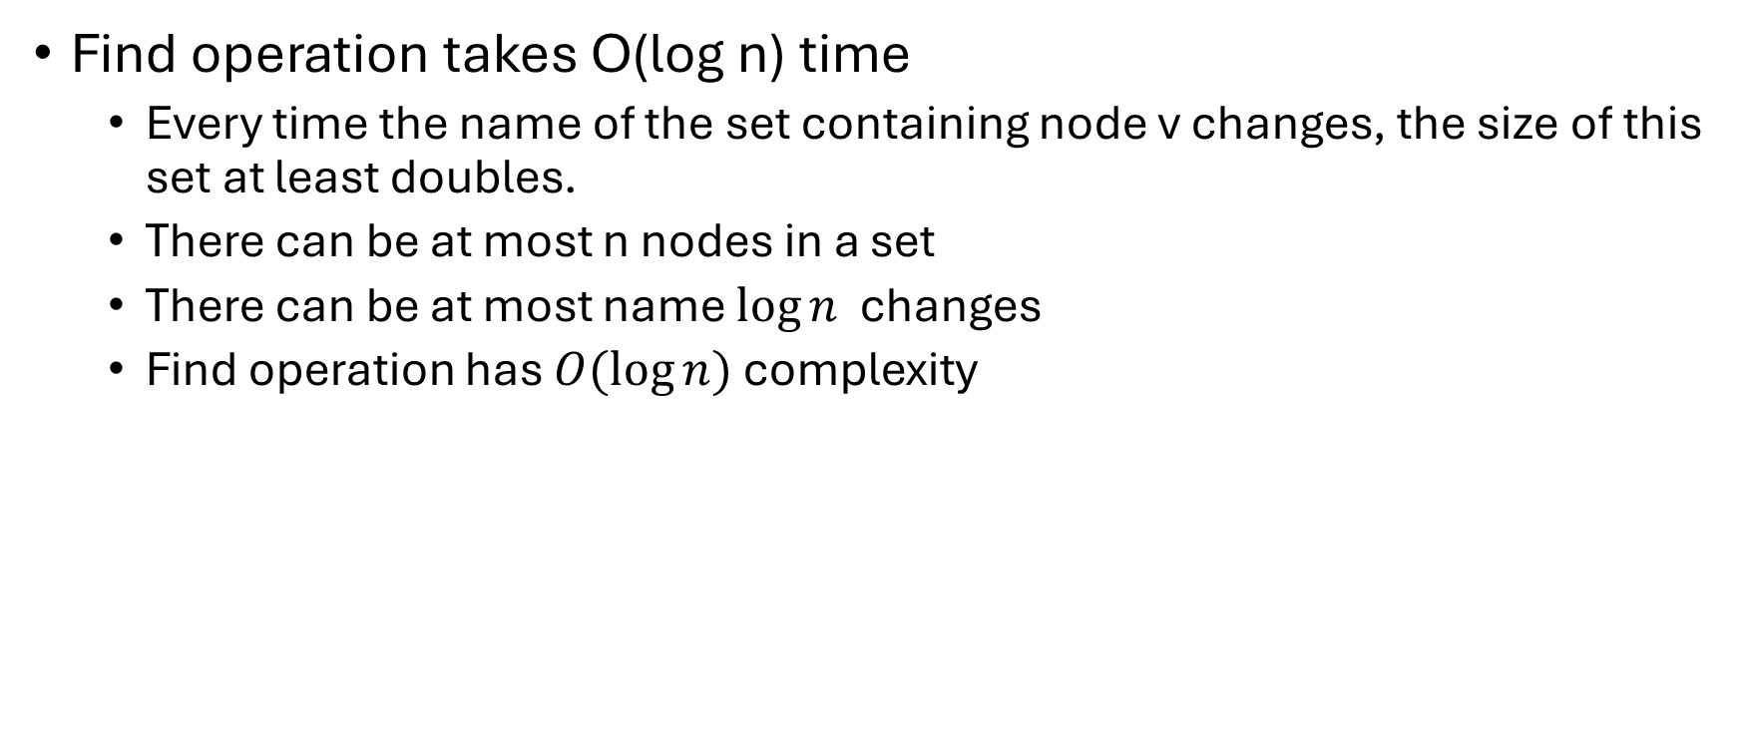
A Better Union-Find
Find operation takes O(log n) time
Every time the name of the set containing node v changes, the size of this set at least doubles.
There can be at most n nodes in a set
There can be at most name $\log{n}$ changes
Find operation has $O(\log{n)}$complexity

Slide 24
A Better Union-Find
def MakeUnionFind(n)
for i = 1 to n
parent[i] = i
def Union(x, y):
# Assuming x and y are
# from two disjoint sets.
if x’s set is larger
parent[y] = x
else
parent[x] = y
def find(x):
if parent[x] == x
return parent[x]
else
return find(parent[x])

Slide 25
A Better Union-Find with Path Compression
def MakeUnionFind(n)
for i = 1 to n
parent[i] = i
def Union(x, y):
# Assuming x and y are
# from two disjoint sets.
if x’s set is larger
parent[y] = x
else
parent[x] = y
def find(x):
if parent[x] == x
return x
else
parent[x] = find(parent[x])
return parent[x]

Slide 26
Reference
Union-Find
KT Section 4.6

